Slide 1
From How to WOW!
Kathy Moe, CAVS
UnityPoint Health - Fort Dodge, IA

Slide 2
From How to WOW!
We cannot deliver what customers expect

Slide 3
From How to WOW!

Slide 4
From How to WOW!
We must give them twice as much as they expect with quadrupled enthusiasm and personal attention

Slide 5
From How to WOW!
The promise:
Tips and tricks to create
Engaged personnel
Loyal customers
Increase revenue
Examples and techniques for
Merchandise display
20 proven, creative ideas you can use
Inspiration

Slide 6
From How to WOW!
1. Discover marketing ideas that you can easily implement to increase traffic, interest and sales for your shop.

Slide 7
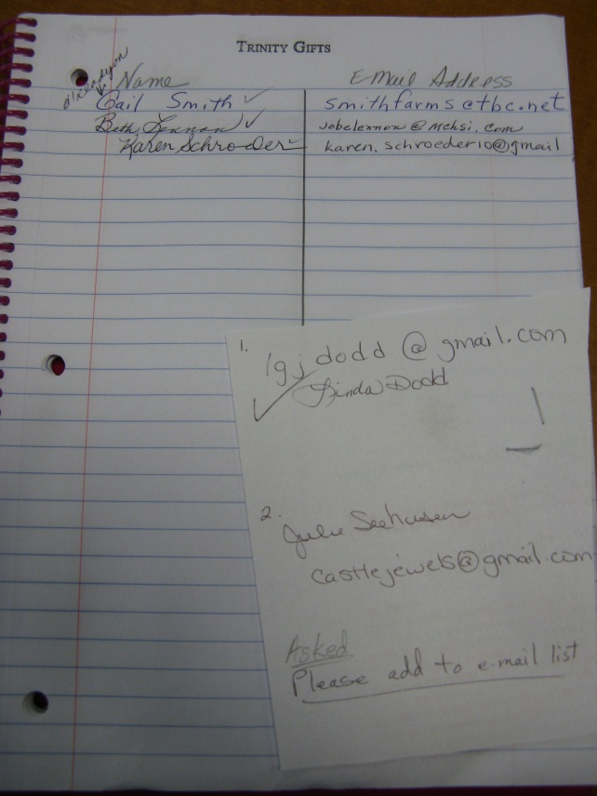
WOW!
FROM HOW TO
1. E-mail -external
Ask for e-mail addresses!
Sign up in the shop…use an old fashioned notepad!
Auxiliary or membership cards in the shop
Simple marketing ideas

Slide 8
WOW!
FROM HOW TO
2. E-mail - internal
Send “All” e-mails to staff – 1x weekly
Give staff a head’s up on the ‘latest and greatest’
Promote spontaneous e-mail ONLY events…
Today Only, Until Noon, Until The Rain Stops, Until The Next Baby’s Born, etc.
3. Pay for EVERYTHING in the gift shop
Auxiliary membership & fundraisers (Angels of Love)
Employee Perk Spot
Stamps
Simple marketing ideas

Slide 9
WOW!
FROM HOW TO
Video Monitors
Surprise Gifts
Brown Bag Sales
Do your own version
of “Elf on the Shelf”
8. P w/P
9. Play FUN music
Simple marketing ideas

Slide 10
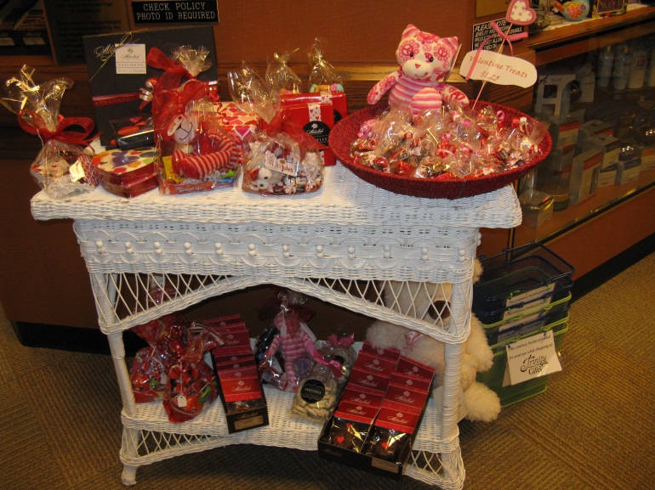
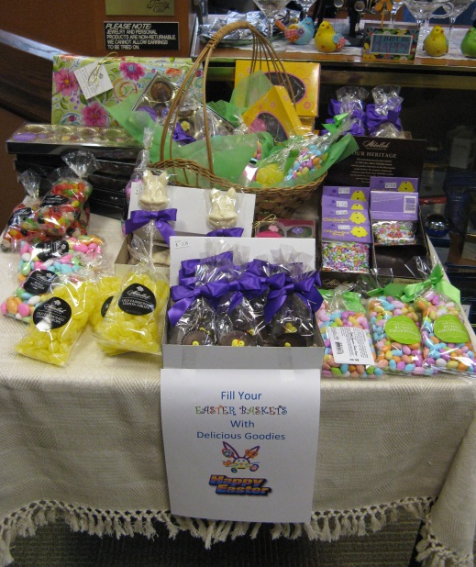
WOW!
FROM HOW TO
10. Quick Pick or Grab ‘n Go
Simple marketing ideas

Slide 11
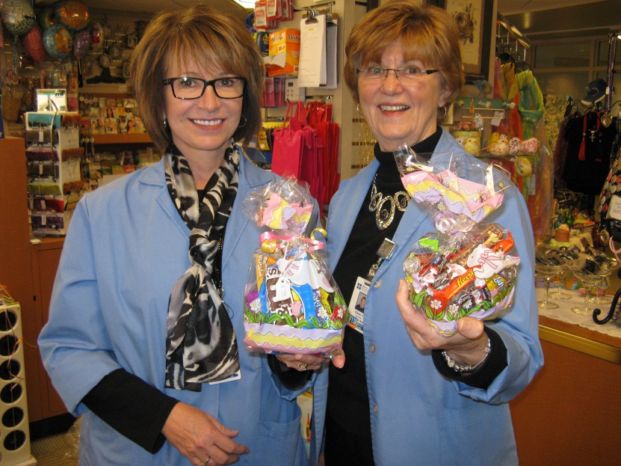
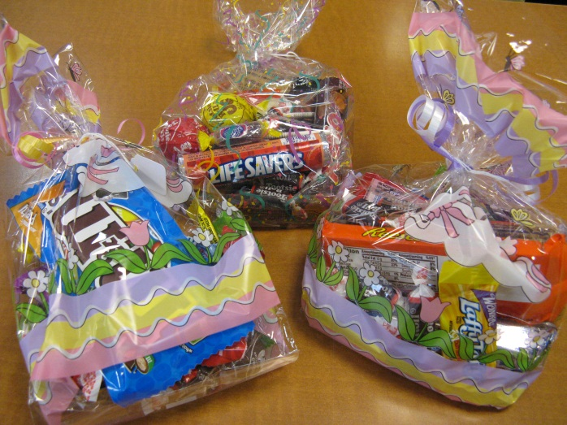
WOW!
FROM HOW TO
11. Keep ‘Snack Attack Packs’ always ready
Simple marketing ideas

Slide 12
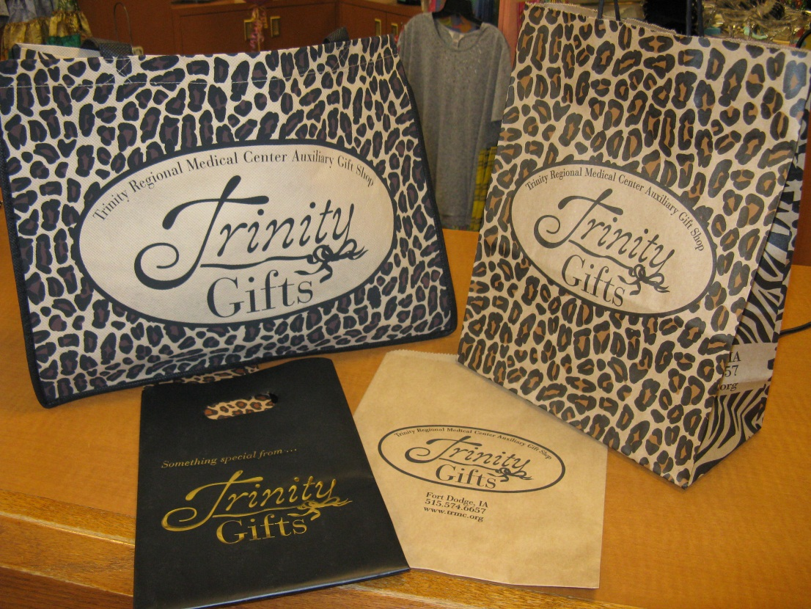
WOW!
FROM HOW TO
12. Custom Bags
13. Supply your logo bags for special events in the hospital and community
Simple marketing ideas

Slide 13
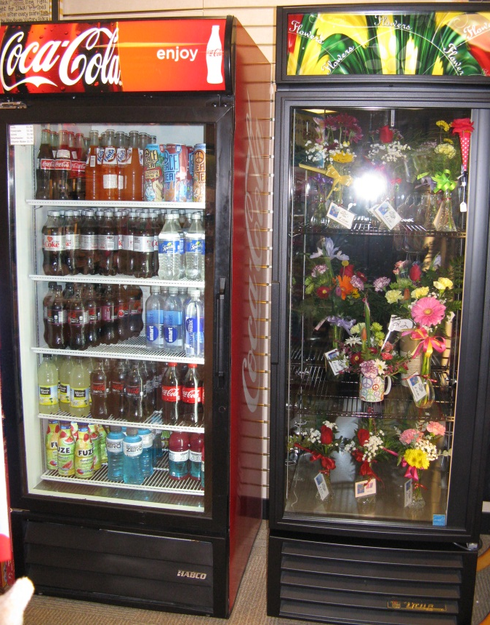
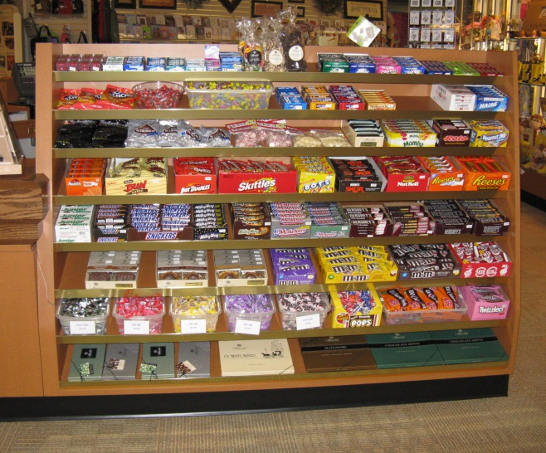
WOW!
FROM HOW TO
Stamp or sticker the back of enclosure cards with shop name & phone
15. Create your own “O List”…post a list of “Kathy’s Favorite Things”
16. Use Social Media
17. Place destination items in the BACK of the shop
Simple marketing ideas

Slide 14
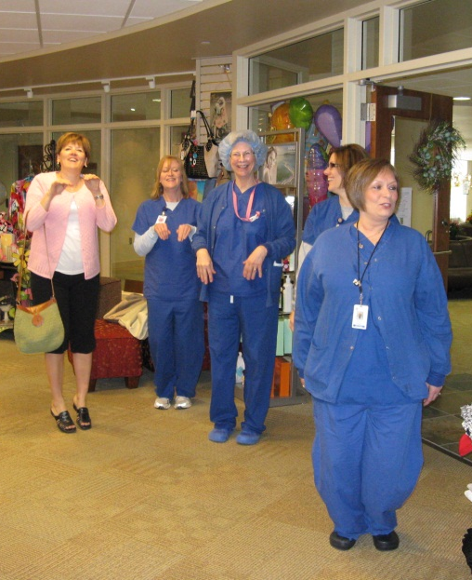
WOW!
FROM HOW TO
18. Make it FUN…NO day should be boring!
Brown Shoe Day
National Bubble Wrap Day
Celebrate the Royal Birth
Bunny Hop Day
12 Days of Christmas
Queen for a Day
Oreo Day
Mary Poppins Day
Johnny Appleseed Day
Count Your Buttons Day
Simple marketing ideas

Slide 15
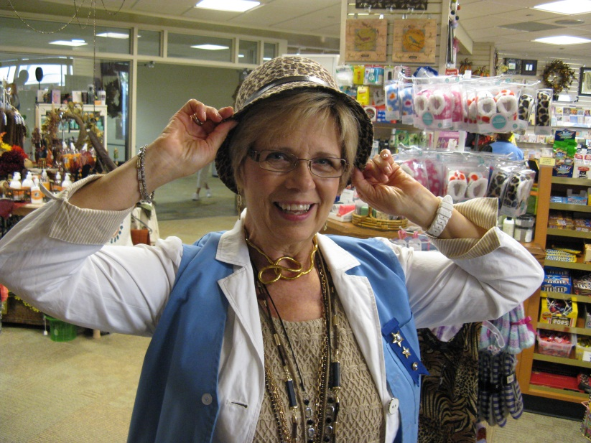
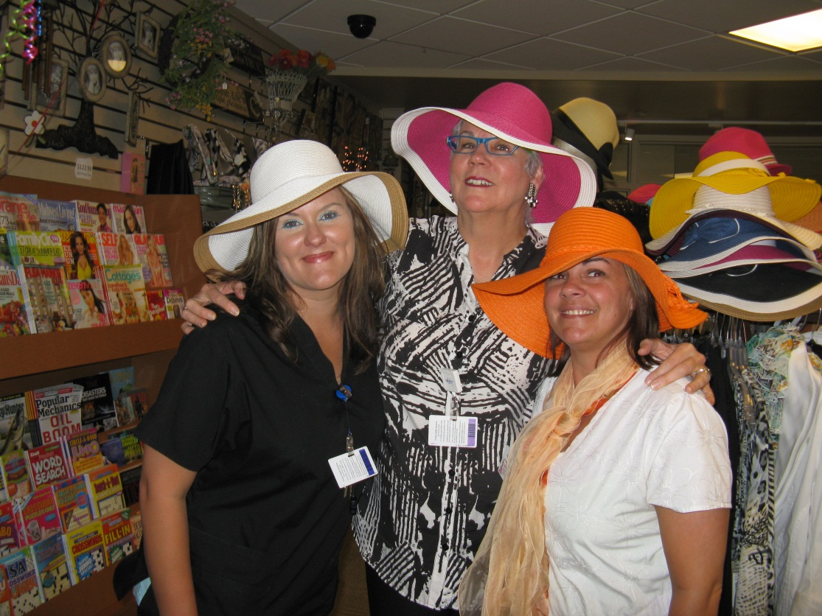
WOW!
FROM HOW TO
Take pictures of staff enjoying your merchandise…trying on hats, scarves or dancing with the plush
Post or frame the photos!
Simple marketing ideas

Slide 16
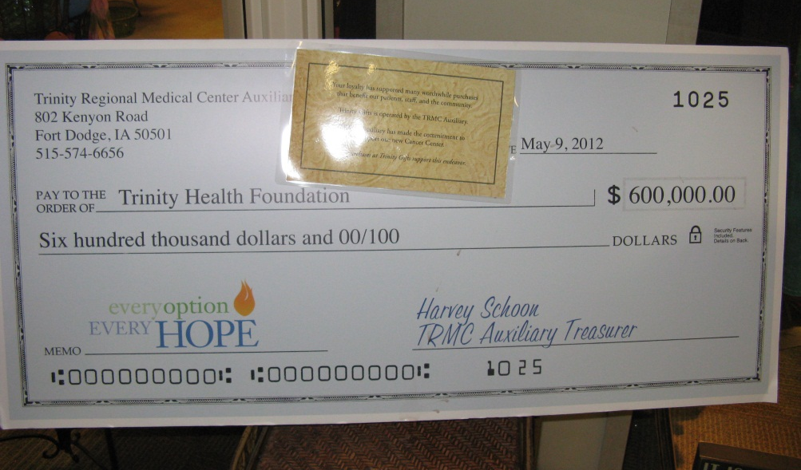
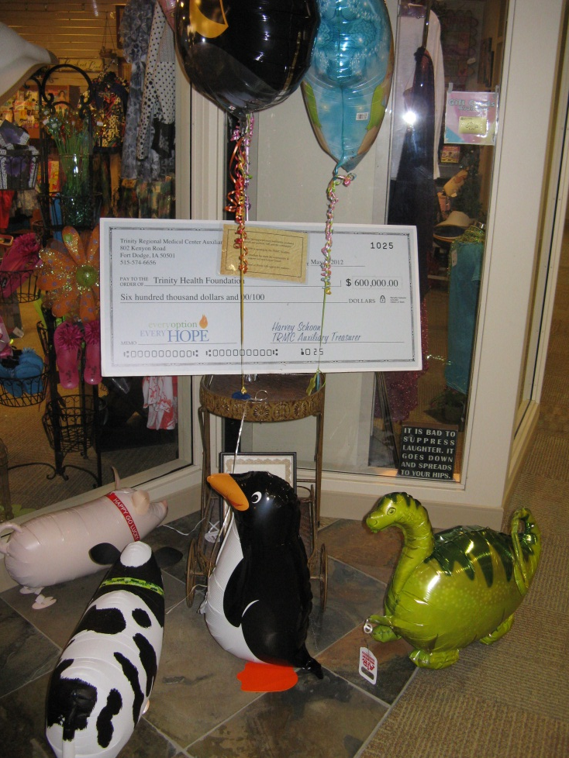
WOW!
FROM HOW TO
20. Promote your donations
Simple service ideas

Slide 17
From How to WOW!
2. Discover more ideas you can implement that will engage your staff and volunteers to create a WOW customer service experience that will result in greater revenue and loyalty for your shop.

Slide 18
WOW!
FROM HOW TO
Payroll deduction
Assign greeter and ringer positions
Hold a training session IN the shop – close the shop and advertise you’re having a volunteer and staff in-service
Write a newsletter JUST for gift shop volunteers and staff
Know Do Share
Every merchandise item has a story to tell
Simple service ideas

Slide 19
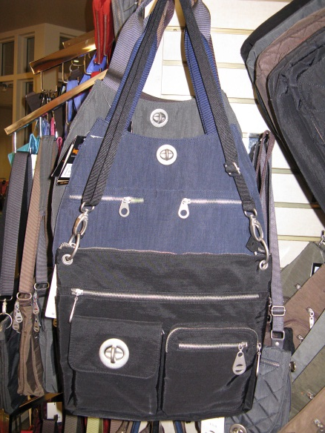
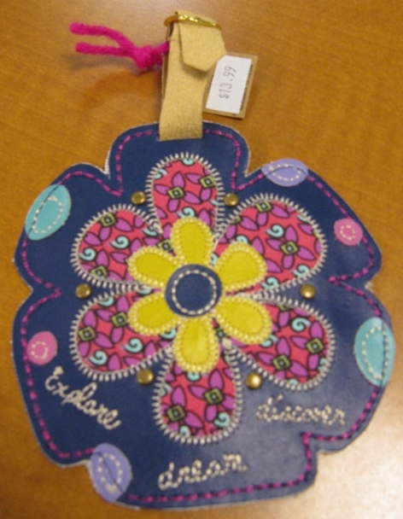
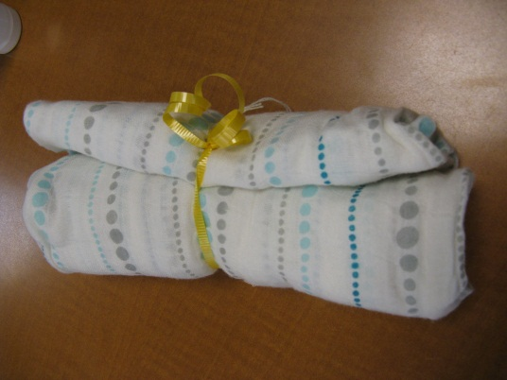
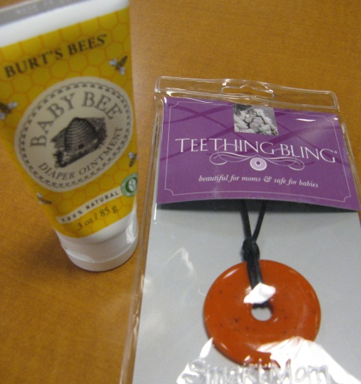
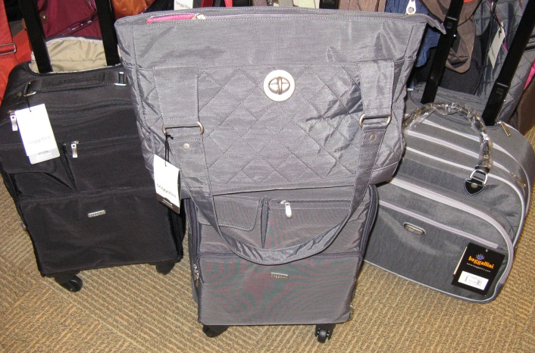
WOW!
FROM HOW TO
6. Offer add-on purchase ideas
Simple service ideas

Slide 20
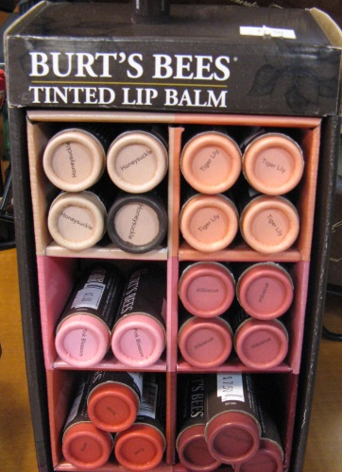
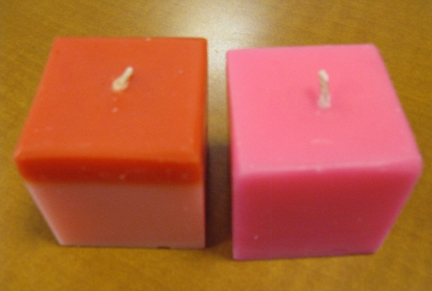
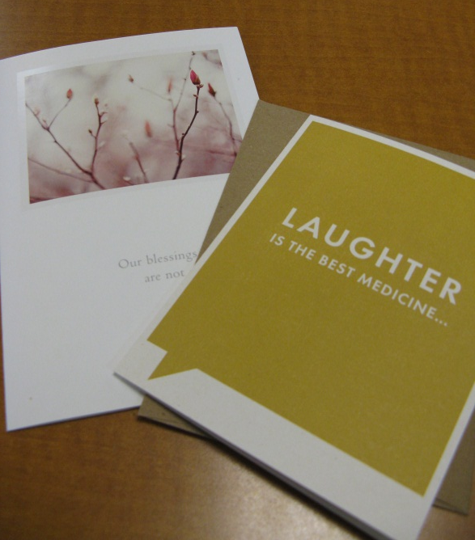
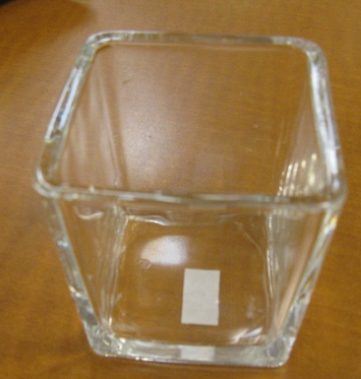
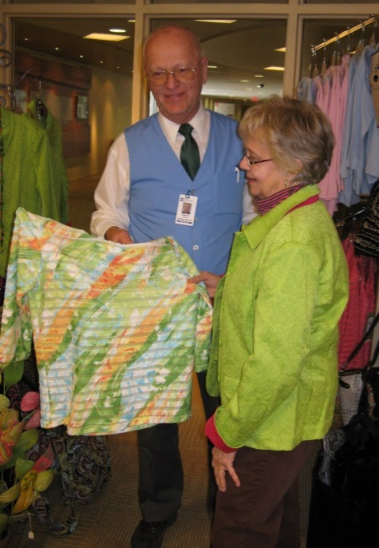
WOW!
FROM HOW TO
6. Offer add-on purchase ideas
Simple service ideas

Slide 21
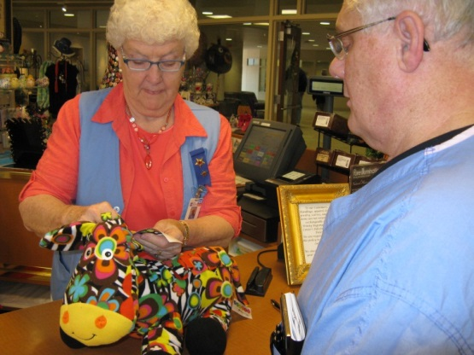
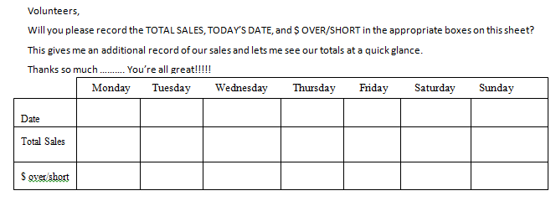
WOW!
FROM HOW TO
7. Offer to remove price tags
8. Keep a daily total of sales in the shop
Simple service ideas

Slide 22
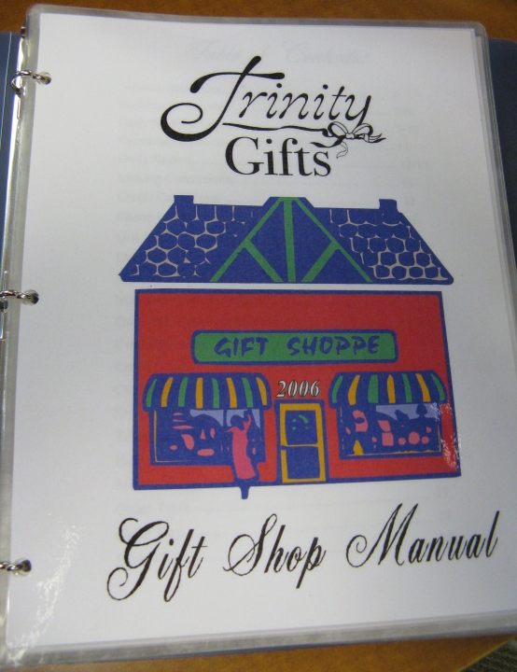
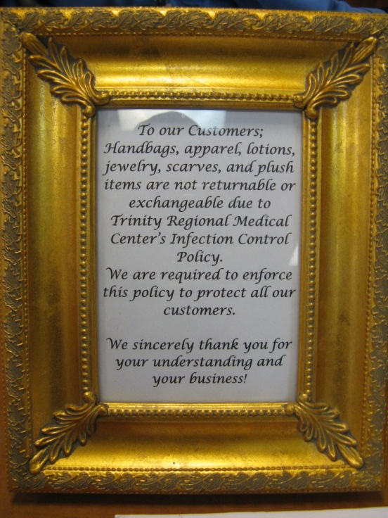
WOW!
FROM HOW TO
9. Hold a contest for who uses the most customer’s names
10. Keep a beautiful LEATHER BOUND book of special requests & OFI’s
12. Never stop educating and talking about shop policies; keep them handy
Simple service ideas

Slide 23
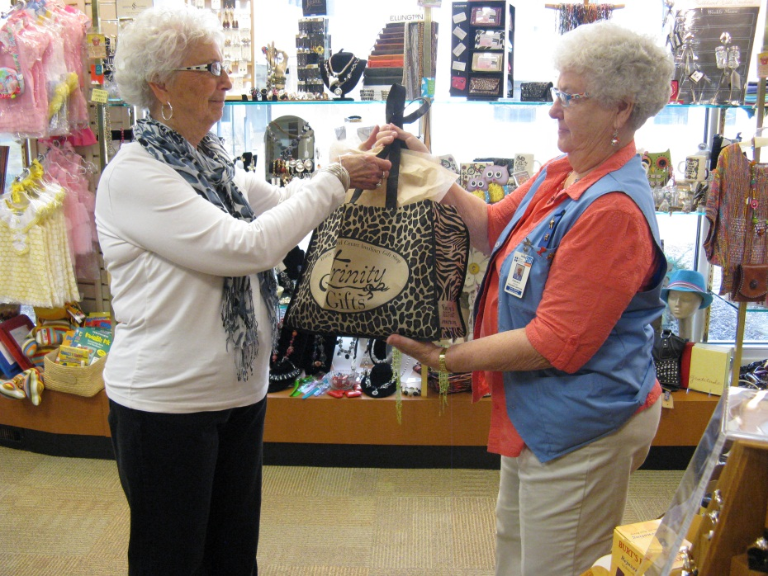
WOW!
FROM HOW TO
13. Call customers when special merchandise arrives
Thank browsers
Affirm buying decisions
Practice 10 in 10!
Remember the Butt Brush Theory
‘No problem’ IS a problem
Personalize your ‘delivery’
Simple service ideas

Slide 24
WOW!
FROM HOW TO
20. Chose a service theme every year
CARE – Create A Remarkable Experience,
Customers Are Really Everything
It Counts Up – track ATV, daily sales
SSSSS – Swift Service Served with a Super Smile
Counter Attack! – Get out from behind the counter,
Meet and Greet
Simple service ideas

Slide 25
From How to WOW!
BONUS IDEA!!!
41. Write thank you notes to volunteers AND customers

Slide 26
From How to WOW!
Here’s some more
WOW!

Slide 27
From How to WOW!
Display WOWs
Bottom’s UP
A door is not a door
A chair is not a chair
Displays are to be read
Color coordination calms
Right On!

Slide 28
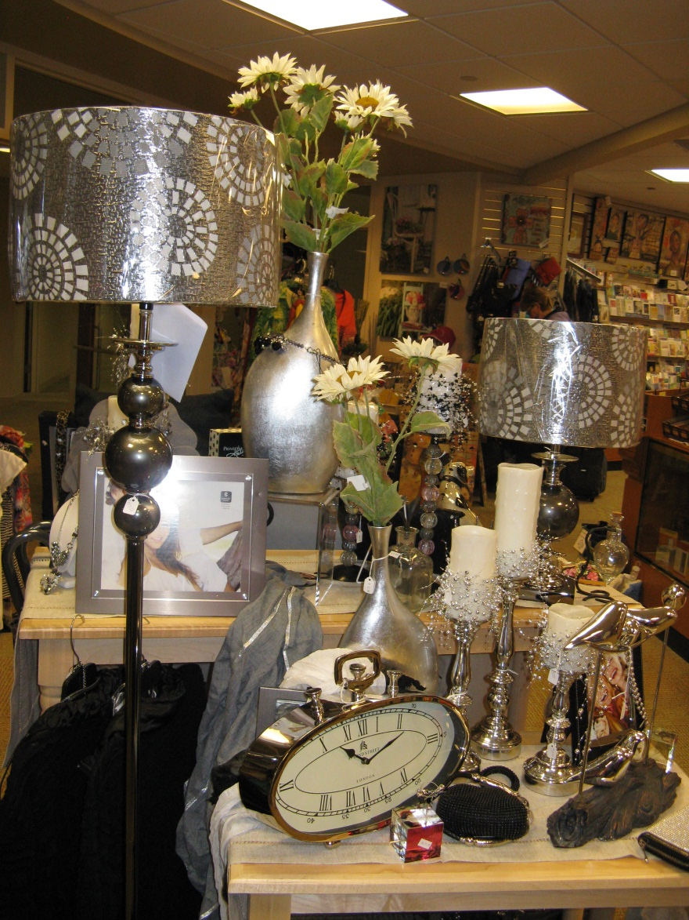
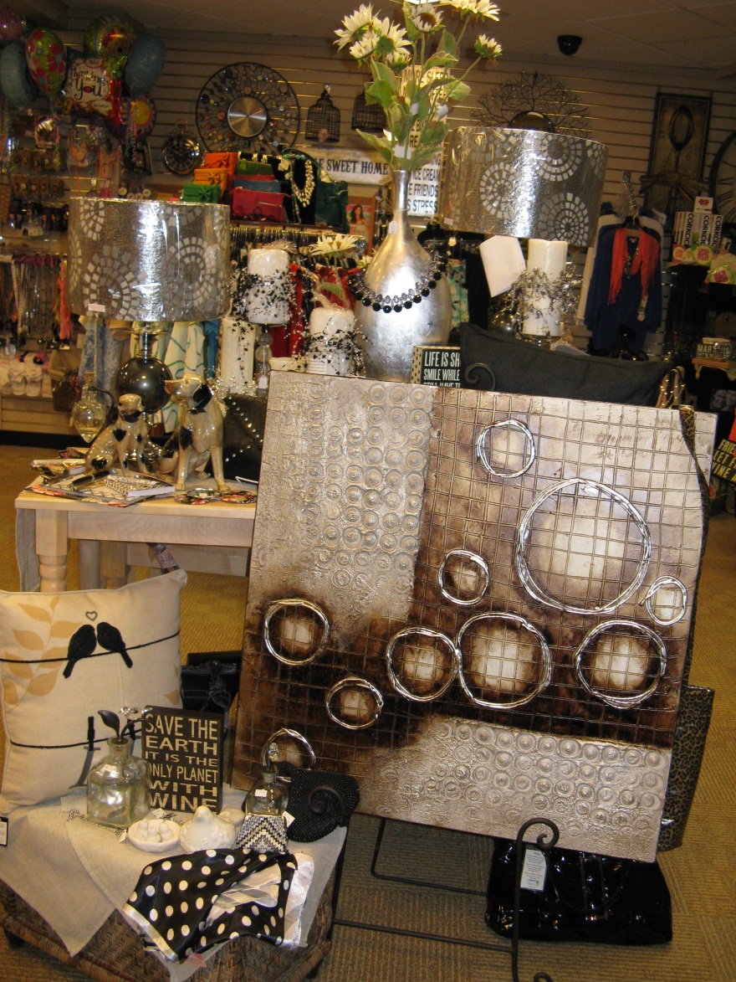

Slide 29
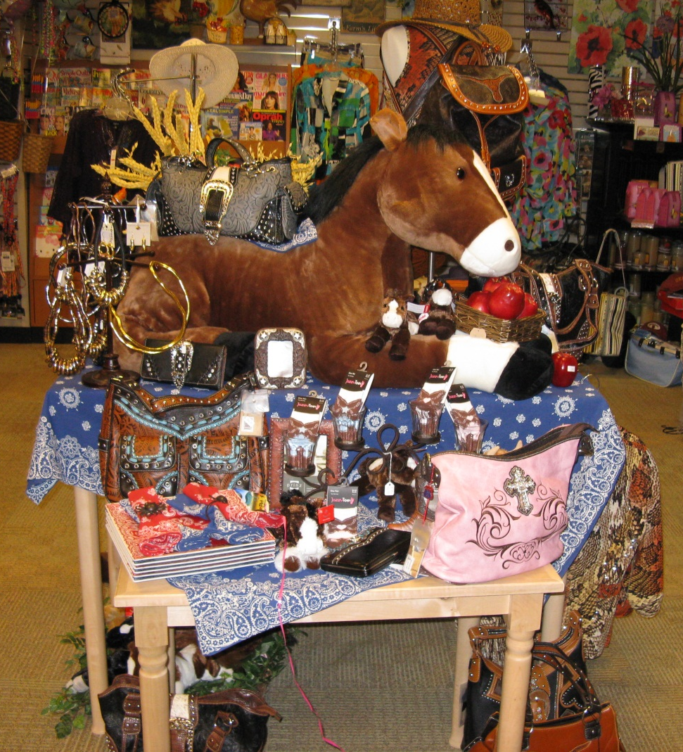
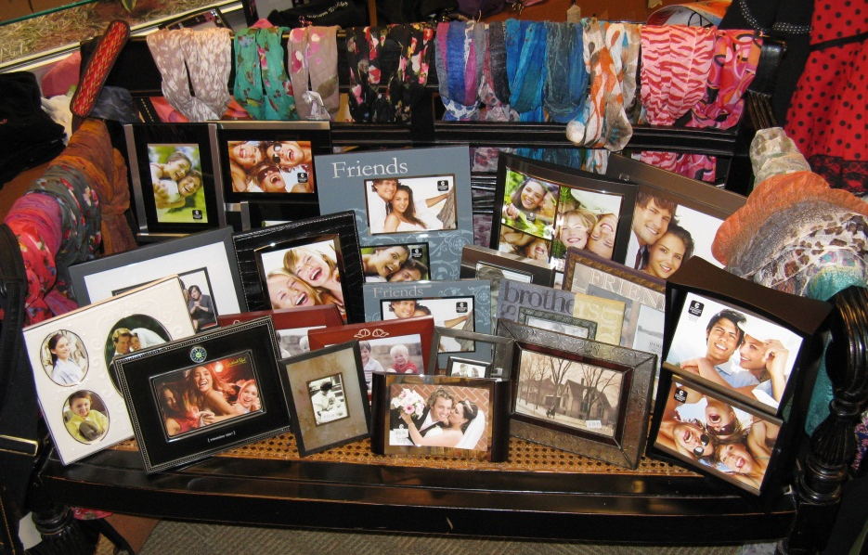
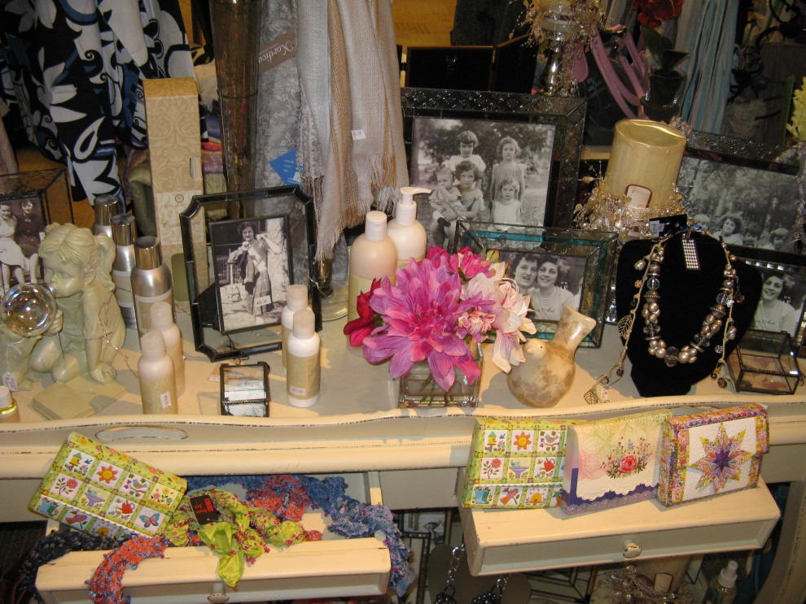

Slide 30
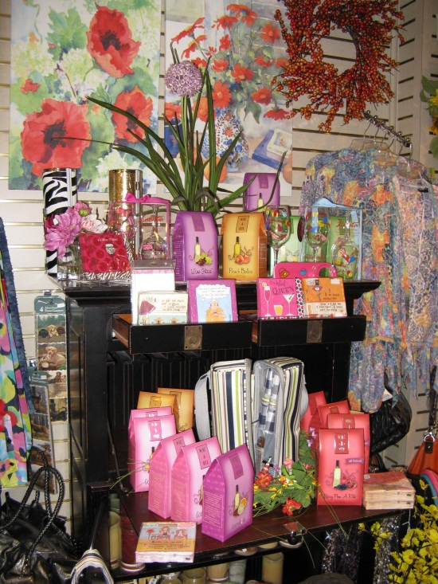
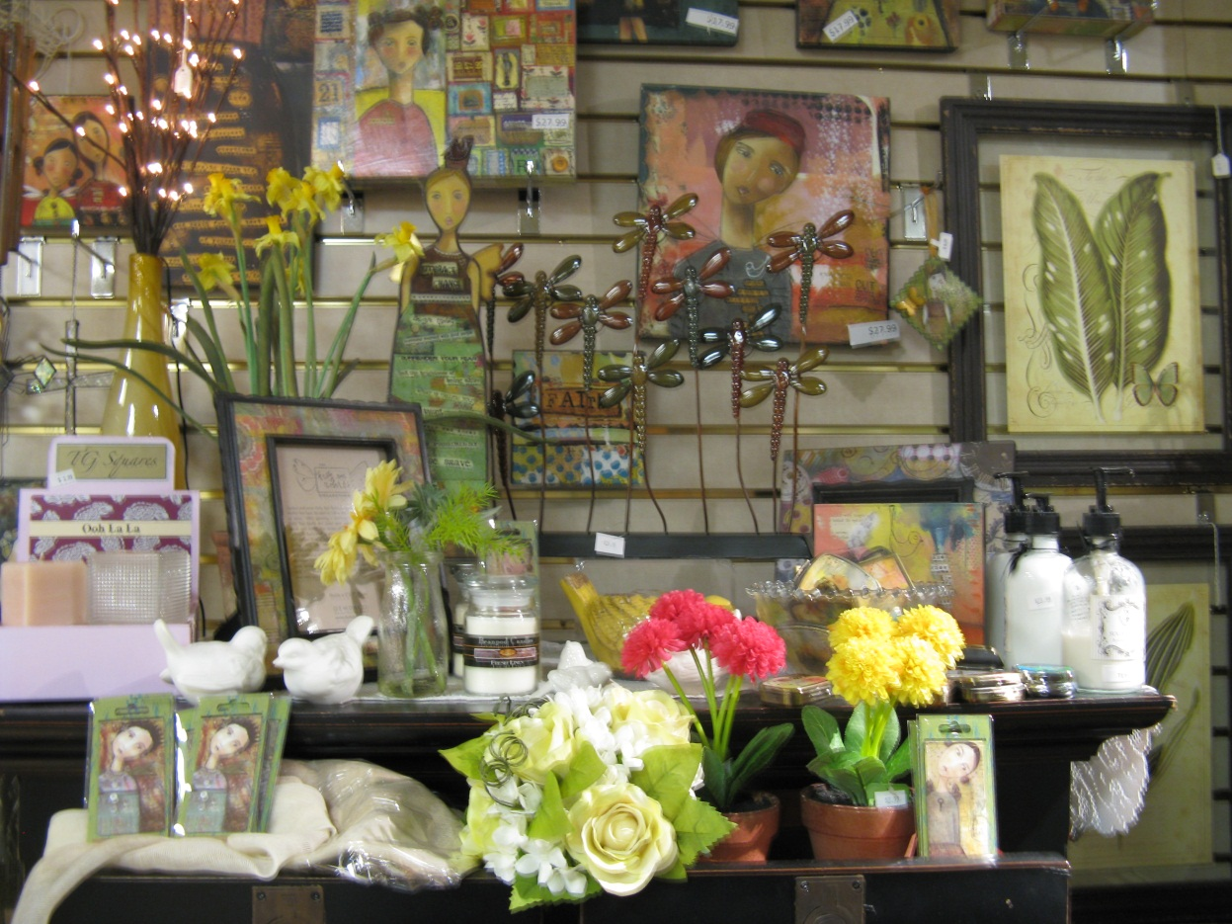

Slide 31
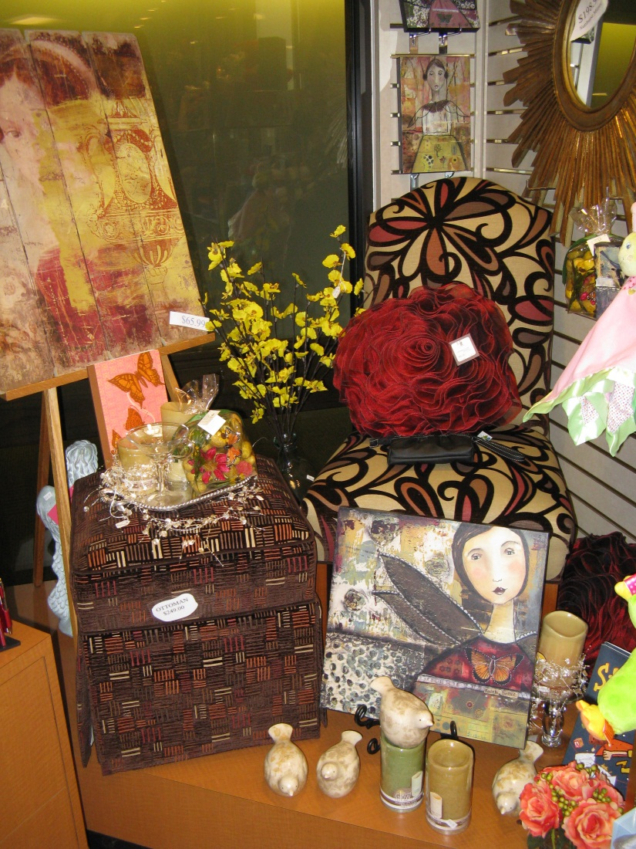
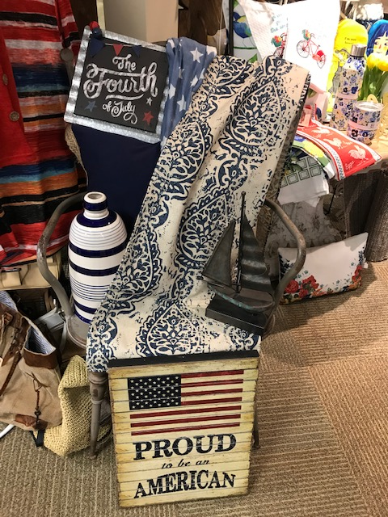

Slide 32
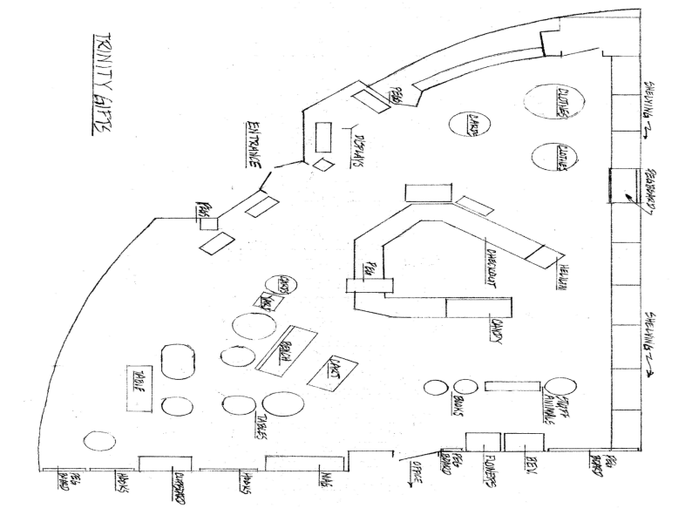

Slide 33
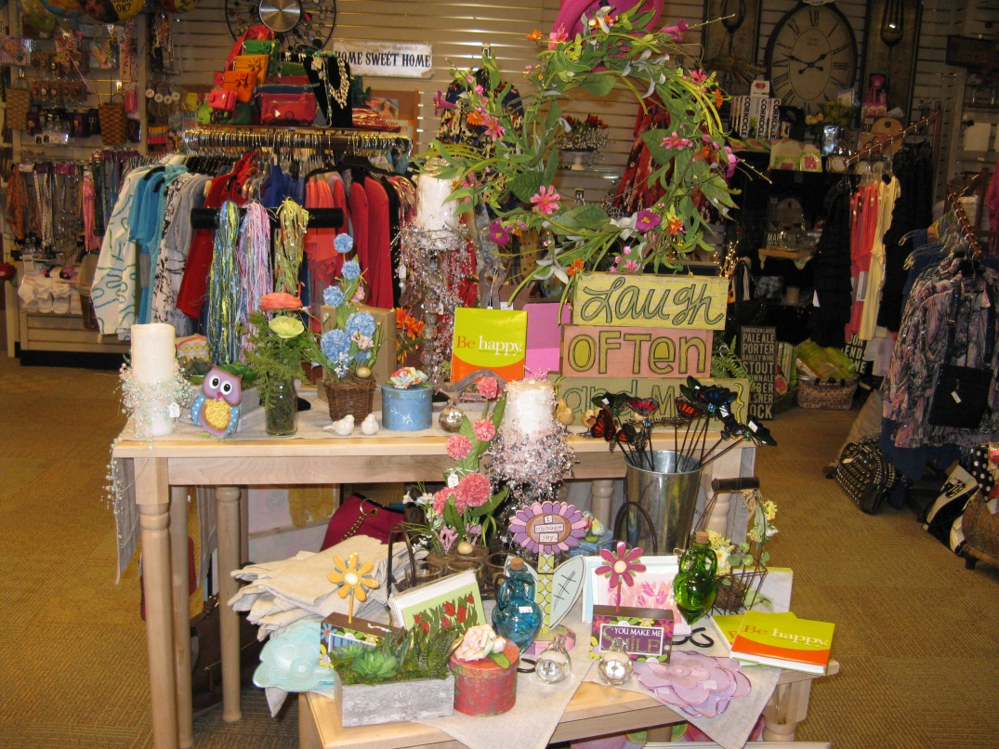

Slide 34
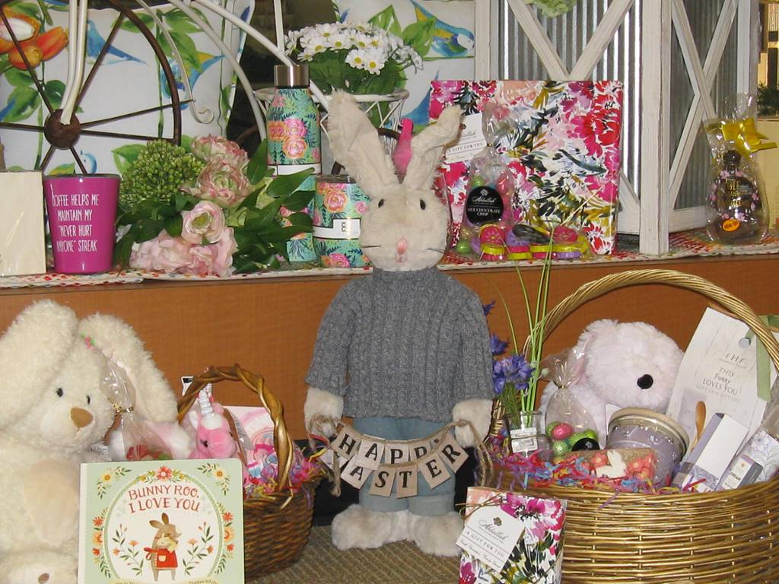
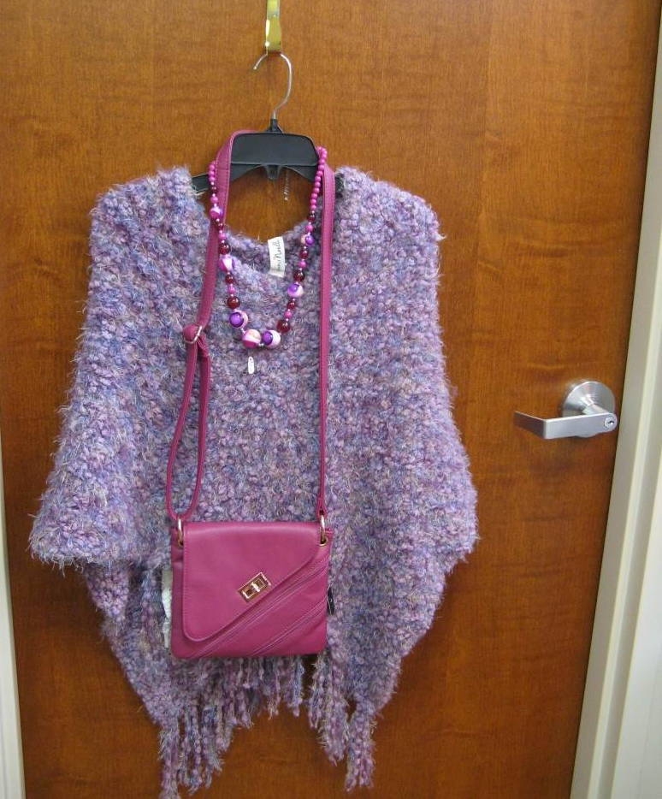

Slide 35
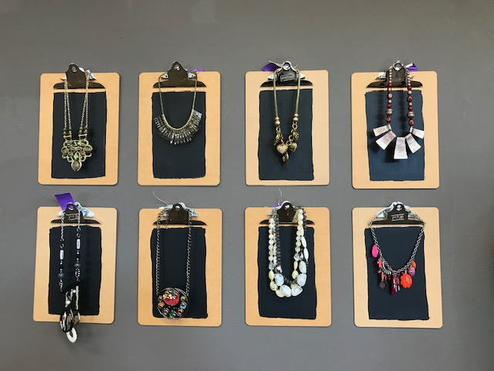
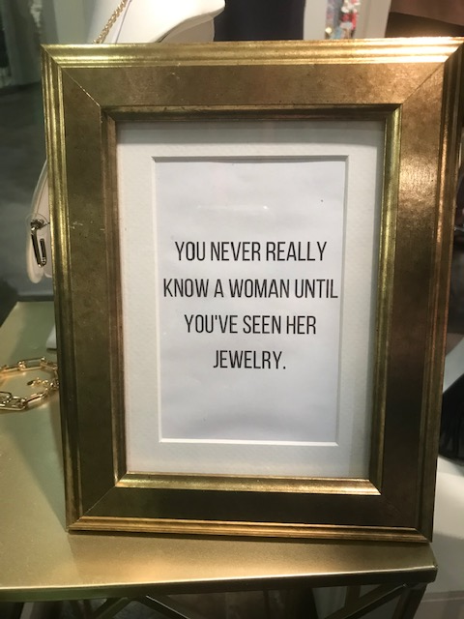

Slide 36
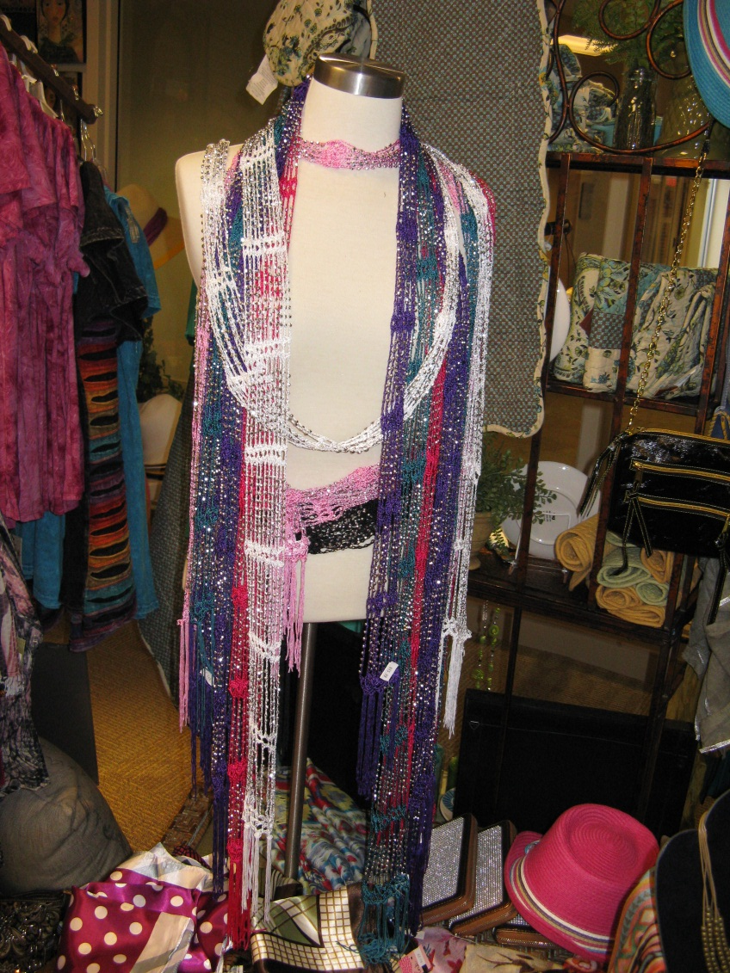
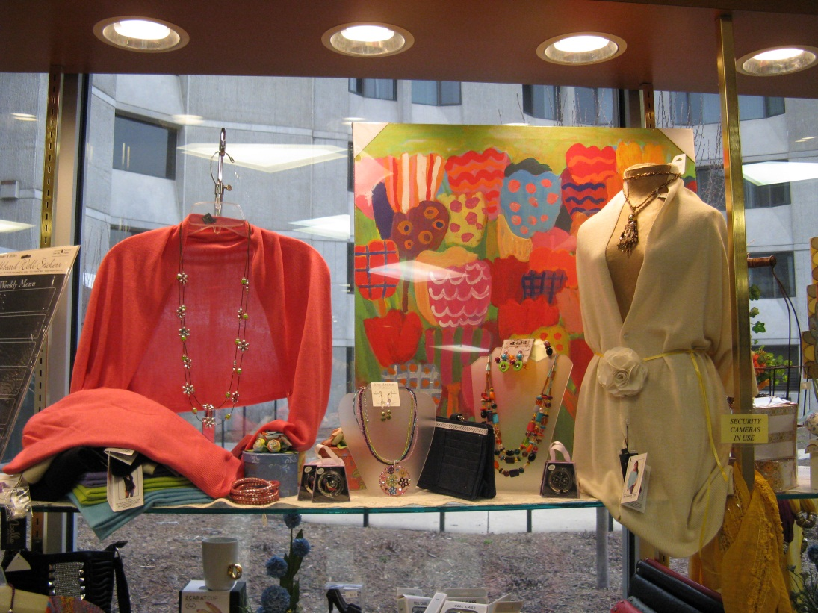

Slide 37
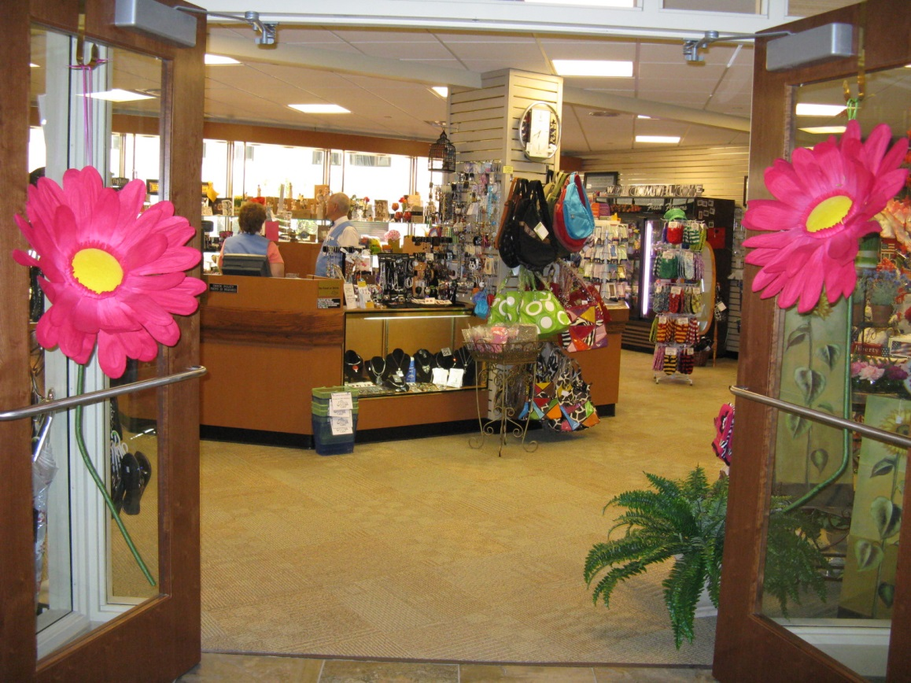
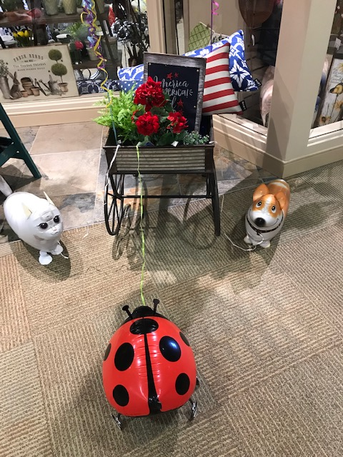
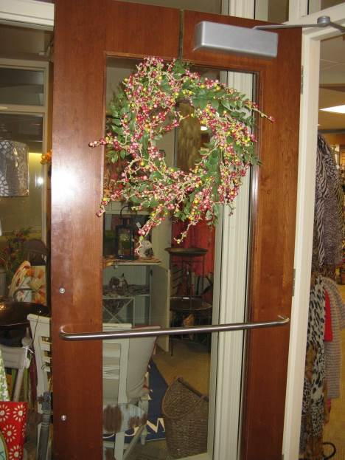

Slide 38
DZ

Slide 39
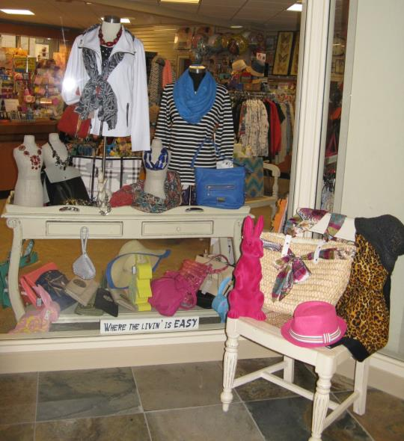
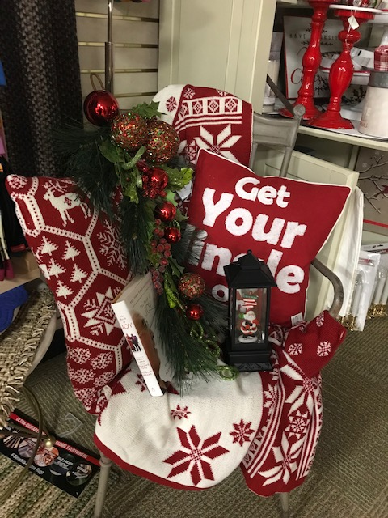

Slide 60
From How to WOW!
Be
exceptional
Be extraordinary

Slide 61
From How to WOW!
Go home and WOW!
‘em

